Slide 1
Embedded Web Service Development
Embedded SOAP Server
อาจารย์ที่ปรึกษา ผศ.อภิเนตร อูนากูล
ผู้จัดทำโครงงาน นายธเนศ ชูวิเศษวณิชย์
นายธีรยุทธ สุทธิสุวรรณ

Slide 2


Agenda
Overview
  Background
  Objective
  Goal
  Benefit
Scope of Project
  Design
  Software Configuration
  Test
  Framework
Future Work

Slide 3


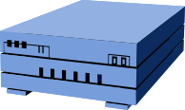
Managing Ubiquitous Device
Project Overview
Embedded Web Service
Device
16 bit device
Network
Management Station
PC based

Slide 4



Background
XML
HTML
TCP/IP
Technology
Standard
Connectivity
Presentation
Programmability
Innovation
FTP, E-mail, Gopher
Web Pages
Browse
the Web
XML Web Services
Program
the Internet

Slide 5


Background
We want to Communicate between application
SOAP (Simple Object
Access Protocol)
  Distributed Object Framework
  Open Standard Protocol
  Design for use with HTTP
  Use XML Structure
  Can be used complicated method
  Messaging between application

Slide 6

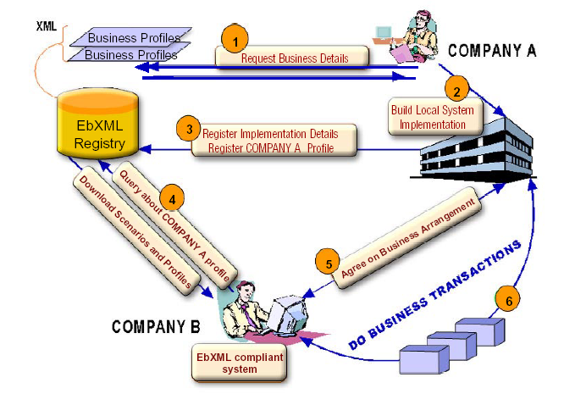
Background
Web Service

Slide 7
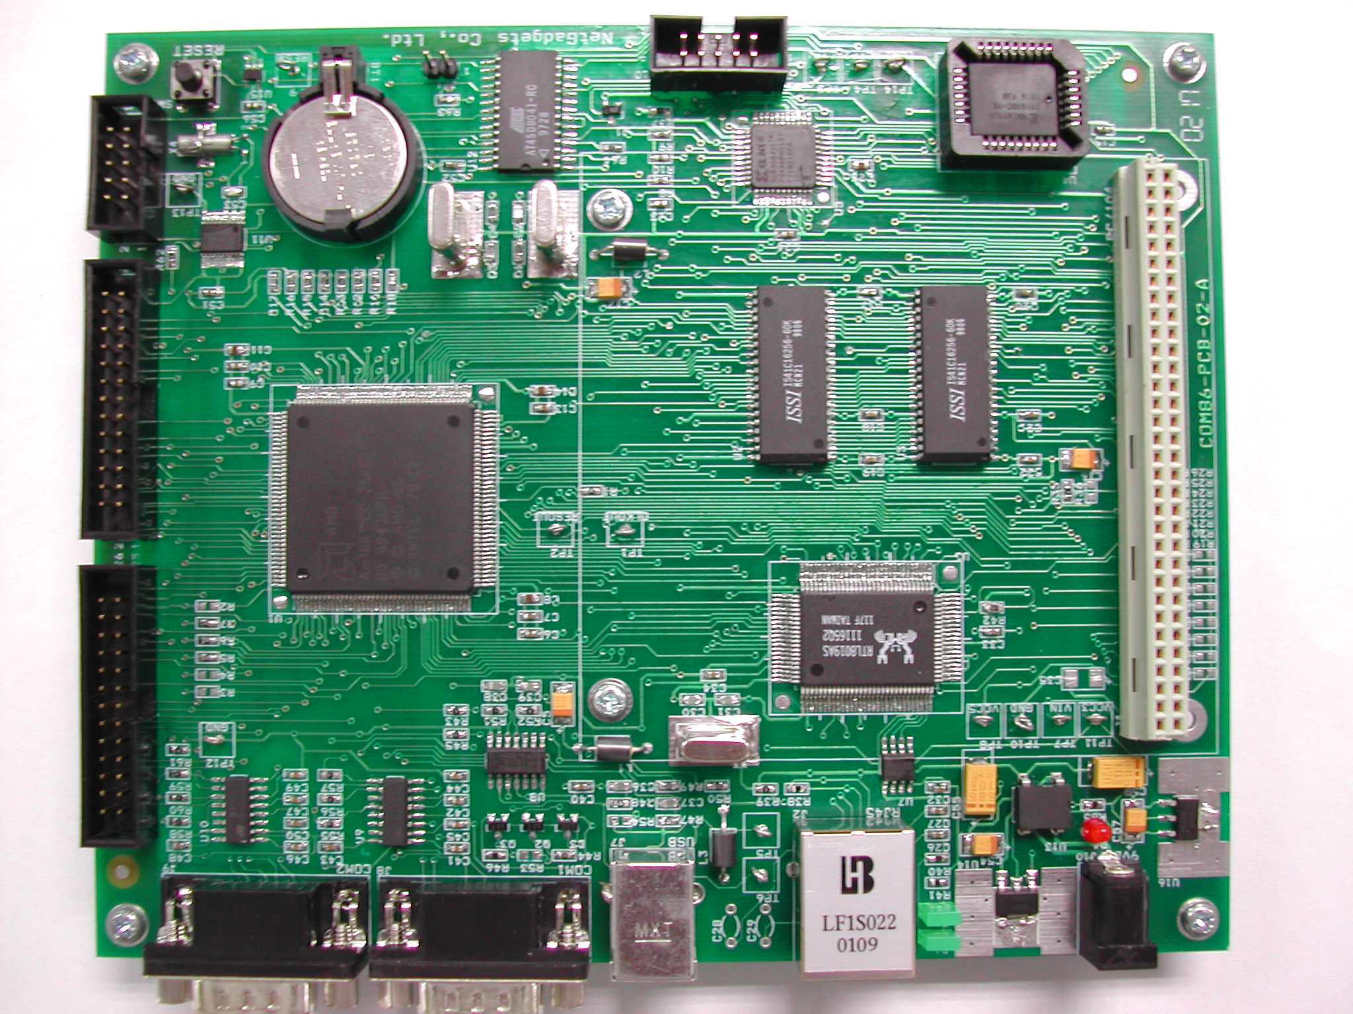
Background
Com86
Why Embedded?
  Environment in work
  Reduce Cost
  Support OS & TCP/IP Stack
  Many Interface to connect devices
  Support in Thailand

Slide 8

Background
Embedded Web Service
  No Commercial EWS today !!!
  Open Source Project
    eSOAP (under development)
      For 32-bit Processors
      Difficult to port down on 8,16 bit

Slide 9



Background
Embedded Web Service Development
Project’s 45
Mr. Suwit
Mr. Akekarach
Embedded Web Service Library Package

Slide 10

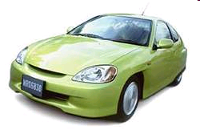



Background
Real-Time in Real-World

Slide 11
Project Proposal

Slide 12
Objective
Restructure Embedded Web Service to
Real-time & Multi-Task processing
Multi-Protocol Extension
Developing Framework for Web Service Developer Easy to Implement

Slide 13
Goal
Embedded SOAP Server Library Package
Framework for implement Web Service
    Service Development
    Protocol Extension

Slide 14
Related Technology

Slide 15

Web Service Overview
Web Service
Open
Internet
Protocols
UDDI
Universal Description,
Discovery, and Integration
WSDL
Web Services
Description Language
SOAP
XML & HTTP

Slide 16
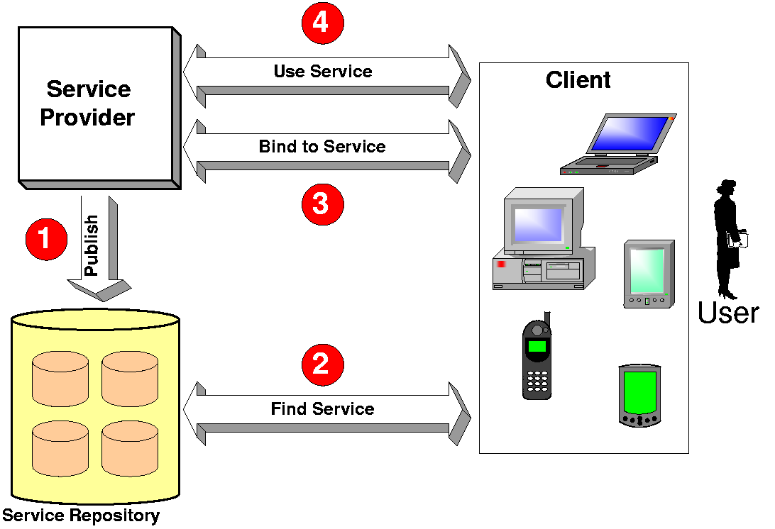
Web Service Overview
SOAP

Slide 17
Web Service Overview
SOAP
UDDI
Service Publication / Discovery
SOAP (Simple Object Access Protocol)
provides a simple and lightweight mechanism for exchanging structured and typed information
WSDL
Service Description
SOAP
XML-based Messaging
HTTP
Network

Slide 18
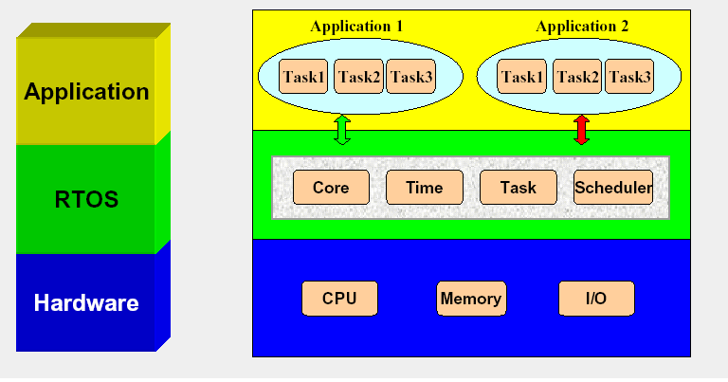
Real-Time System
Real-Time Kernel

Slide 19
Design

Slide 20
Embedded Web Service
Context Diagram
Service
Code
Service
Code
Client
Application
Client
Application
Embedded
Web Service
Register
Embedded
Web Service
Communication
Communication
UDDI
Registry
UDDI
Registry

Slide 21
Embedded Web Service
Web Service Architecture
RPC Service Architecture
Service Code
Service Code
Service Code
Service Code
Service Code
Service Code
SOAP
XML
HTTP
RPC
TCP/IP
Message
Agent
Transport

Slide 22

Embedded Web Service
RPC Service Architecture
  Web Service (on HTTP)
  Web Service (on SMTP)
  Web Service (Multi-Protocol)
  Web Service & Web CGI (Multi-Protocol)
HTTP
Server
SMTP
Server
HTTP
Agent
RPC
SOAP
Handler
SOAP
Service
Caller
Service 1
Service 2
SMTP
CGI
:
Service n
Network
Module
Protocol Interpreter & Message Parser
SOAP Parser & XML Parser
Real-time OS
Hardware

Slide 23

RPC Service
Structure
Mechanism
Service
Agent
Service
Network
Transport
Module
Agent
RPC Protocol
Service
Agent
RPC Protocol
Service
Task
Factory
Task
Factory
Task
Factory
RPC Task
RPC Task
RPC Task
Service Dispatcher
Service Dispatcher
Service Dispatcher
RPC Platform
Data structure
& Parser
RPC Task
RPC Task
RPC Task
RPC Task
Service Manager
Service Manager
Real-time OS
Hardware
Protocol
Analyzer
Protocol
Analyzer
Protocol
Analyzer
RPC Task
RPC Task

Slide 24
RPC Service
Handling Request Packet
Empty Socket Queue
create Task()
Task
Factory
Task
Factory
HTTP
(established)
HTTP
Network
Transport
Module
SMTP
(established)
SMTP
FTP

Slide 25
RPC Service
RPC Task Initiating
Empty Task Queue
RPC Task
Task
Factory
Task Mbox 1
RPC Task
Data Mbox 1
HTTP
RPC Task
RPC Task
Task Mbox 2
RPC Task
Data Mbox 2
FTP
Task Mbox 3
RPC Task
Data Mbox 3
SOAPObj
Task Mbox 4
RPC Task
Data Mbox 4
SMTPObj
FTPObj

Slide 26
RPC Service
Service
Registry
Service Initiating
Service 1
Empty Service Task Queue
Service 2
regist()
regist()
Service Manager
Task Mbox 1
Service Task 1
Service Task 1
Data Mbox 1
Task Mbox 2
Service Task 2
Service Task 2
Data Mbox 2
Task Mbox 3
Service Task 3
ServiceObj1
Data Mbox 3
ServiceObj2
Task Mbox 4
Service Task 4
Data Mbox 4
ServiceObj3

Slide 27
RPC Service
Service Calling
return
Data Mbox 1
Result
run()
RPC Task
RPC Task
Service Task 1
Service Task 1
Service Task 1
call
Task Mbox 1
call
Data Mbox 1
Parameter
Service Dispatcher
Service
Registry
find
Service 1
Service 2

Slide 28

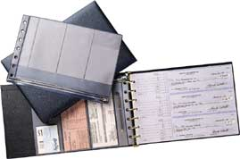
Software Configuration
Component Diagram
Class Diagram
Sequence Diagram

Slide 29
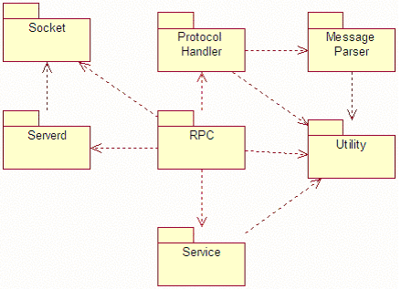
Component Diagram

Slide 30
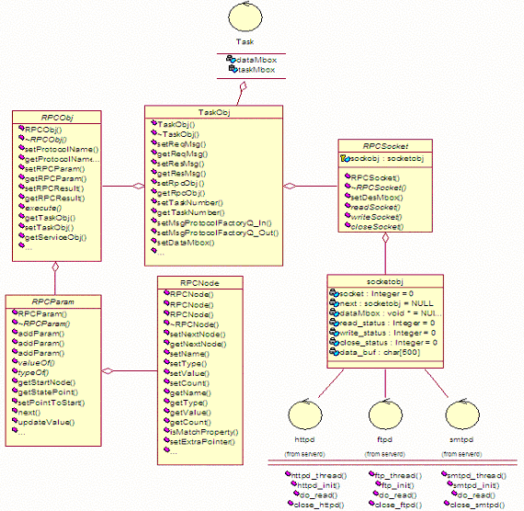
Class Diagram
RPC Service

Slide 31
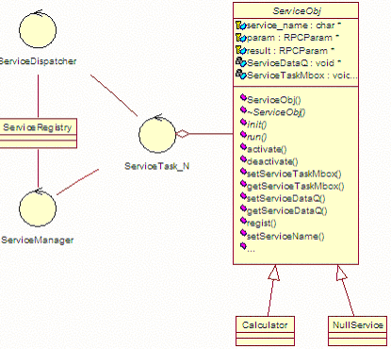
Class Diagram
Service

Slide 32
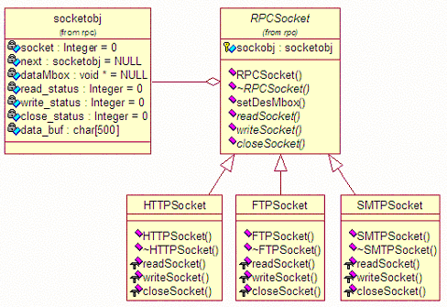
Class Diagram
Socket Connection

Slide 33
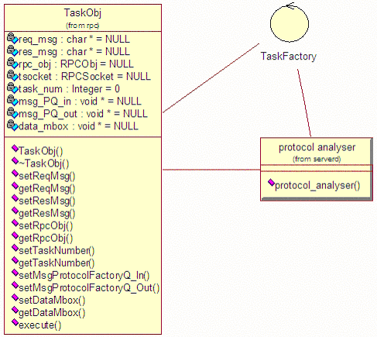
Class Diagram
Task Creation

Slide 34
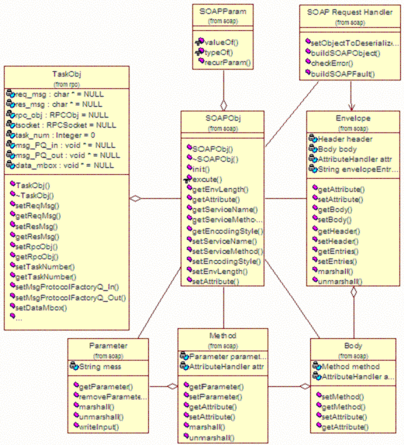
Class Diagram
SOAP Desializer & Parser (SOAP IN)

Slide 35
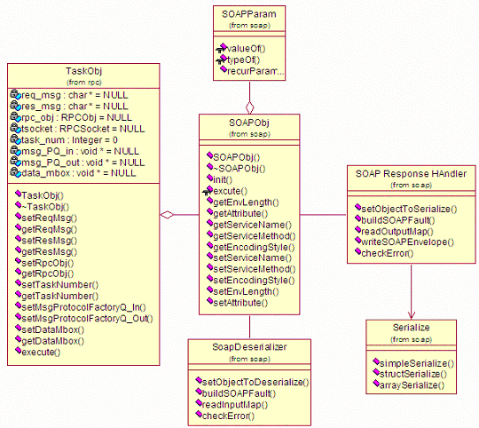
Class Diagram
SOAP Serializer (SOAP OUT)

Slide 36
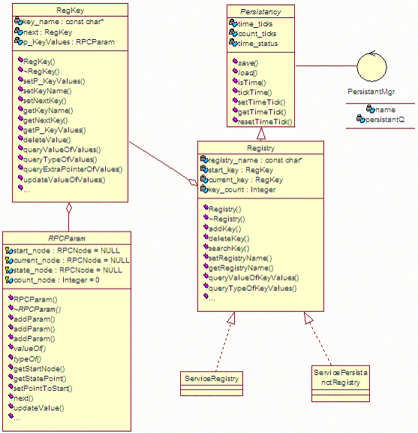
Class Diagram
Registry

Slide 37
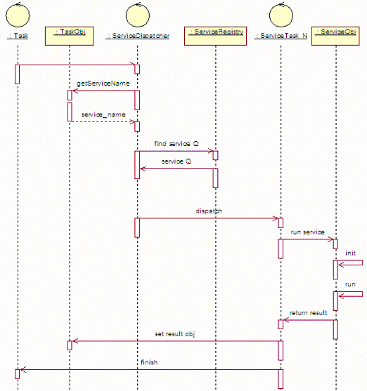
Sequence Diagram
Call Service

Slide 38
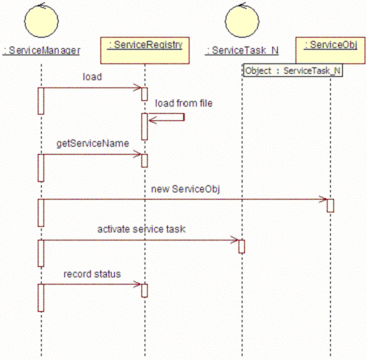
Sequence Diagram
Start Service

Slide 39
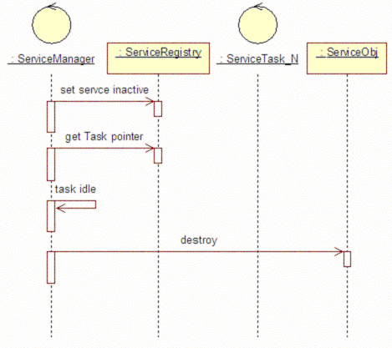
Sequence Diagram
Stop Service

Slide 40

Devepment Platform
Hardware | COM86
Real-time Kernel | μC/OSii
Protocol Stack | Lwip
Programming Code | C/C++
Compiler | Borland C++ 3.1

Slide 41
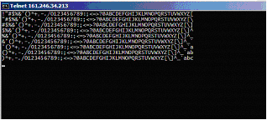
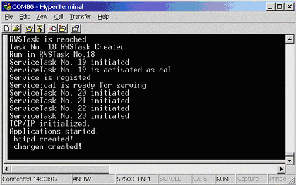
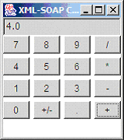
Test
Call Service (Multi-tasking)

Slide 42
Framework
Embedded System
Platform Developer
Service Developer
add-in
add-in
Service
Service User
& Application
add-in
Agent
Service
Network
Transport
Module
Agent
RPC Protocol
Service
Agent
RPC Protocol
Service
control
RPC Platform
Data structure
& Parser
Service Administrator
Real-time OS
Hardware

Slide 43


Future Work
Component Independency
Memory Map & Monitoring
Testing for others protocol
Minimizing for 8-bit device

Slide 44

Q & A

